Slide 1
Purna Health Management System Balanced Living: the Key to Health and Happiness
Overview

Slide 2
Professor Dr. Svami Purna advises and recommends: ‘For good health and happiness and all round wellbeing one should follow a good balanced framework for life that includes:
1. good food (balanced and healthy sattvic nutrition);
2. good sleep (sound, deep, carefree and relaxed 6-8 hours sleep);
3. good exercise (walking, asanas, swimming and moderate physical activities);
4. good mind (positive approach towards life in thought and action including good deeds, voluntary work or seva without any condition, expectation or agenda, gain or reward);
5. good meditation (review, contemplation, gentle analysis, silence, pranayama, positive sound and music, focus of mind on nature including flowers and trees);
6. good human interaction and relationships (pleasant, positive gossip free interaction with family, friends, workplace associates and the outside world where interaction occurs with human beings, and responsibility for self - no blame or complain);
7. good interaction with plants and animals (recognising them as us with the same atma and force as they are also our life supports).
These are the simple Seven Commandments for a good life and lasting wellbeing and happiness.’
Notes:
1. Food: Balanced meals with foods rich in nutrients: proteins, vitamins and minerals (sattvic in the Vedic tradition).
2. Exercise: Moderate activities such as walking, light yoga / asanas, swimming and other moderate physical activities.
3. Meditation: Regular gentle analysis and review of daily behaviors and thoughts, contemplation / focus of the mind on flowers, trees, nature etc., breath exercises (pranayama), silence and engaging with uplifting sounds and music.
4. Sleep: Regular sound, deep, carefree and relaxed 6-8 hours nightly.
5. good meditation (review, contemplation, gentle analysis, silence, pranayama, positive sound and music, focus of mind on nature including flowers and trees);
6. good human interaction and relationships (pleasant, positive gossip free interaction with family, friends, workplace associates and the outside world where interaction occurs with human beings, and responsibility for self - no blame or complain);
7. good interaction with plants and animals (recognising them as us with the same atma and force as they are also our life supports).

Slide 3
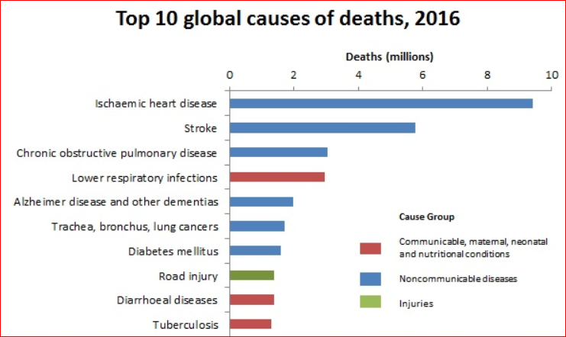
Today’s health challenges call for a complete and integrated solution
Chronic diseases are at an all time high
Contributors to chronic diseases include:
Poor diet
Processed foods / red meat*
Foods lacking the required nutrients
Foods infused with chemical ingredients
Lack of regular physical activity
Imbalanced lifestyle
Incomplete educational information on body, mind and spirit as an integrated whole
*W.H.O. October 2015 - processed red meat category 1, red meat category 2A
World Health Organization, May 2018

Slide 4
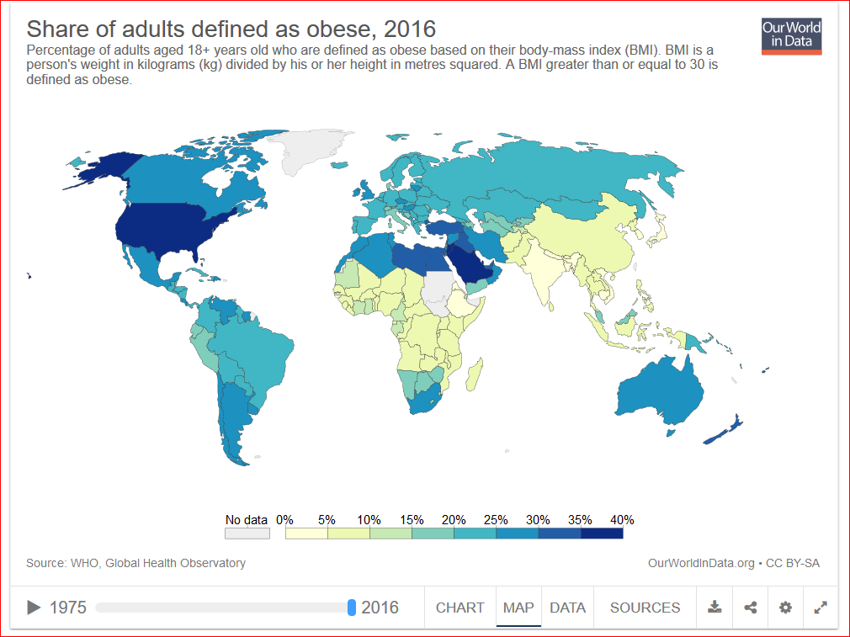
A complete and integrated solution addresses the increasing challenge of obesity

Slide 5
Environmental challenges have further aggravated our health as well as the existence of planet life
Over population is a serious challenge.
In 62 years the world population has increased 3x to 7.4 billion.
Population
Ocean Acidification
Over the last 250 years, surface acidity of the ocean has increased by an est. 30%. It is expected to increase by 150% by 2100, further dissolving the skeletons of creatures.
An overwhelming majority of climate scientists, believe that human activities are currently affecting the climate and that the tipping point has already been passed.
Climate Change
Pollution
Pollution of air, water and soil by chemical compounds take many years to breakdown.
Humans have destroyed and continue to destroy the habitats of species on a daily basis.
Loss of Bio-
diversity
Ozone Layer Depletion
Depletion of the ozone layer has been mainly attributed to the release of chemical pollution containing the chemicals chlorine and bromide.
Annually, humans convert an est. 120 million tons of nitrogen from the atmosphere into reactive forms such as nitrates for use in fertilizers and food additives.
Phosphorus and Nitrogen Cycles
Over Fishing
It is est. that by 2050 that there will be no fish left in the sea due to over fishing and rising population
By 2050, two thirds of the worlds population will not have access to clean water. Up from one third today.
Water
Deforestation
Since 1990 half of the worlds rain forests have been destroyed.
Planet Herald Earth, July 2018

Slide 6
Dr. Purna is bringing forward Vedic knowledge as the solution for today’s challenges
Professor, Dr. Svami R.A.G. Purna is a Himalayan Master, Philosopher and Vedic Teacher who holds doctorates in:
Medicine, psychology, philosophy, and literature
His Teachings:
Are beyond any particular tradition
Address all aspects of the human condition
Provide answers to life’s deepest questions
He teaches the way to:
Lead a healthy and meaningful life through Vedic principles, presented as the Purna Health Management System (PHMS)
Balance is a key ingredient of PHMS
Notes:
Svami’s original name was Rameshwaran Anand Giri , hence the abbreviation R.A.G.

Slide 7
Vedic knowledge is a complete and pure system of living originating from the Indus civilization
The Vedas, (meaning: true knowledge), are ancient, sacred perennial texts of the Indus civilization which predate other ancient texts
Emanated from Divine guidance
Heard by Rishis, Sages and Seers during meditation
Passed down through oral tradition and later in written form
According to the Vedas, life is divided into four stages:
0-25 years
To build the body and mind, and to study
26-50 years
As a householder with accompanying duties and responsibilities
51-75 years
As semi-retired for dedication to more scholarly and social work
76-100 years
For further development of the spiritual life and spirituality

Slide 8
Vedic knowledge highlights the importance of living in balance with nature by working with the 3 Gunas and the 5 Elements
The three Gunas are the building blocks of the Universe.
Action, passion - relates to Prana (or life-force) and energy
Purity, lightness - relates to the mind and light
Rajas
Sattva
Tamas
Inertia, decay - relates to the body and matter

Slide 9
Applying various practices balances the Elements and increases Sattva Guna leading to improved Health and Happiness
Humans are made up of the five Elements which keep the body functioning
Bones
Body fluids
Earth
Water
Emptiness within body cavities and within atoms
Space
Fire
Body heat, digestive energy
Air
Breathing

Slide 10
Vedic knowledge is categorized by Sciences which contain the practices
Ayurveda, the Science of Life, is one aspect of Vedic teachings that provides practices for health and longevity.
Example
Eat fresh, nourishing foods; exercise mindfully, not forcefully; contemplate on Love, Wisdom, Peace and Compassion in order to increase Sattva.
Yoga, the Science of Union, is accomplished by practicing yogic techniques such as postures (asana), breath work (pranayama) and meditation bringing the body, mind and emotions into balance.
Example
Digestion is governed by the element of fire – “Agni” in Sanskrit. The power of digestion can be enhanced through certain breathing techniques, mantra and meditation.

Slide 11
The key principle of life balance is taking responsibility for applying the practices
The greatest service you can give to the world
is to take responsibility for yourself,
your relationships and your environment.
--Dr. Purna

Slide 12
Another principle is that the body, mind, emotions and spirit are an integrated unit. When one is out of balance, the others are impacted
A constantly worrying mind causes anxiety
An ignored spirit disrupts a higher understanding of life
Anxiety
stresses the physical body
An ignored spirit prevents unconditional love
Mind Imbalance
Spirit Imbalance
An ignored spirit can upset the body’s health
Anger makes the mind irrational
The emotion of anger releases chemicals into body which stresses the body
Physical illness leads to cloudy thinking
Physical illness leads to depression
Emotional Imbalance
Body Imbalance

Slide 13
PHMS is a universal and flexible choice for all people and is complimentary with the United States’ National Prevention Strategy, NPS
PHMS
Applying timeless principles for balancing the physical, emotional, mental and spiritual aspects of life to build a foundation for lasting health and happiness.
Goal
Live in harmony with one’s self, others and the environment
It is recommended that one check with a medical expert, physician or health professional for any specific concerns
NPS
Working together to improve the health and quality of life for individuals, families and communities by moving the Nation from a focus on sickness and disease to one based on prevention and wellness.
Goal
Increase the number of Americans that are healthy at every stage of life.
NPS 2014

Slide 14
The components of PHMS are intended to harmonize the complete person and one’s relationship with the environment
Balanced Life / Stress Management
Balanced Spirit
Balanced Mind
Balanced Emotions
Balanced Yoga
Balanced Nutrition
Balanced
Sleep
Balanced
Environment
Sanctuary for Peace

Slide 15
The practices contained within PHMS support the development of the person when used regularly
Mantra
Contemplation
Music
Emotions
Mind
Spirit
Body
Breathing Exercises
Intention / Prayer
Introspection
Positive Thoughts
Meditation
Service to Others
Mudras
Yoga
Sense Control
Massage
Vegetarian Diet Preference

Slide 16
Intentionally balancing the integrated being results in numerous personal benefits
Unconditional Love
Happiness
Peacefulness
Emotions
Mind
Spirit
Body
Contentment
Compassion
Purpose
Appreciation
Awareness
Health
Understanding

Slide 17
Personal benefits continue to unfold enabling co-existence with the environment more harmoniously
Emotions
Mind
Spirit
Body
Improved Sleep
Improved Relationships
Increased Energy
Focus &
Productivity
Environment / other Life
Respect
Compassion

Slide 18
PHMS is a flexible system enabling easy adoption for self empowerment
Flexibility
PHMS is ideal for every individual regardless of the level of knowledge, interest, experience, intention and discipline
Begin with any practice, although it is recommended that meditation (sitting, walking, contemplation, etc.) should become the cornerstone of your practice
Increase the length of time with your practices and add more practices as you feel is right
Integrate the practices into living
Self Empowerment
Enhance self control by balancing your emotions, calming mental activity, strengthening health and expanding inner wisdom and clarity
Ever increasing inner stability regardless of external situations and relationships
Reduce and eliminate fear and anxiety while improving self confidence

Slide 19
PHMS content supports sincere and consistent practice and application in day to day life
Each component includes practices that are available in booklet format
At a later time, advanced content will be available in class / seminar
Dr. Purna is available at bi-annual retreats, monthly tele-conferences and other events to accelerate the development of balance in all aspects of the being. See Adhyatmik.org for details and ask to be added to the distribution list
PHMS practitioners are available for consultation. Place your request through Adhyatmik.org this is a new bullet Linda
Balanced Living: The Key to Health and Happiness

Slide 20
Addendum
Suggested readings
Example of companies with meditation, yoga and breathing programs
PHMS research
PHMS testimonials
www.adhyatmik.org & www.purnahealth.org

Slide 21
Suggested Readings available at Adhyatmik.org
Booklets available on the Purna Health Management System
Purna Health Management System
Balanced Nutrition
Balanced Sleep
Balanced Emotions
Balanced Mind
Books by Dr. Purna
The Truth Will Set You Free
Balanced Yoga, by Svami Purna
Balanced Yoga (2nd Edition, including Purna Yoga)
Practical Wisdom
So You Shall Know the Truth
Life: A Mysterious Journey
A Technique to Live
Research Article
How a Himalayan Master and Teacher Promotes Healthy Behavior among His Followers in the Vedic Tradition by Emily K. Schulz, PhD, Published January 3, 2018
www.adhyatmik.org & www.purnahealth.org

Slide 22
Enhancing corporate culture through time tested practices will improve the work experience for employees and provide business benefits
A Sampling of Companies Cited in the Press with Meditation, Yoga and Breath Related Programs
Aetna
Apple
Chase Manhattan Bank
First Direct
Forbes
General Motors
General Mills
Google
Green Mountain Coffee Roasters
HBO
Medtronic
Nike
Target
Cited Business Benefits
Reduced employee stress
Reduced health care costs
Increased focus and productivity
Increased compassion for colleagues and customers
Better decisions and leaders
Improved emotional and mental balance / resilience
Lower employee turnover
www.adhyatmik.org & www.purnahealth.org

Slide 23
Both large and small corporations are participating in the emerging trend of adopting PHMS practices
“Companies are investing in the notion that limiting stress will translate into fewer employee absences, lower health care costs and higher morale, encouraging workers to stick around.”
“The belief is that a healthier working experience will result in a happier and healthier workers which makes for a stronger business.”
Green Mountain Coffee Roasters - workers begin shifts with breathing exercises designed to focus them on the task at hand and clear their minds of distractions.
General Mills, the food behemoth, has infused much of its corporate culture with mindfulness meditation.
"It's about training our minds to be more focused, to see with clarity, to have spaciousness for creativity and to feel connected," the company's deputy general counsel Janice Marturano. "That compassion to ourselves, to everyone around us -- our colleagues, customers -- that's what the training of mindfulness is really about."
Huffington Post, by Peter S. Goodman, April 1, 2015
www.adhyatmik.org & www.purnahealth.org

Slide 24
It is because of positive experienes for all parties that the trend will continue
Mark Bertolini, chief executive officer of Aetna, the medical insurance giant, ….as a result of a broken neck... stumbled into yoga and meditation. This is how he eventually came to have his company make meditation and yoga classes available to employees.
“Some people think I’m weird,” Bertolini says. “They say I’m only doing it because of my own experiences. And I say, ‘I may be weird, but I’m also in charge of the company.’”
Last year (2014), Aetna reduced its health care costs by 7 percent - a savings the CEO pegs in part to limiting stress through meditation and yoga.
Google – Spun off a separate organization to teach other organizations about mindfulness and meditation. See the book Search Inside Yourself for Google’s focus.
Promega (Biotech) - “You create a culture of wellness," says Promega's chief medical officer, Ashley G. Anderson Jr. "If you create a culture in which vibrant physicality is an admired thing, you've achieved a lot. A healthy workforce is a productive workforce." Yoga and meditation
Huffington Post, by Peter S. Goodman, April 1, 2015
www.adhyatmik.org & www.purnahealth.org

Slide 25
There is a high correlation between using the PHMS teachings and experiencing improved physical, mental/emotional health, well being and ability to manage stress.
Improvements were dependent upon the frequency of using practices, the number of practices used and the length of time using the practices.
Number of survey respondents: 41
% of Male / Female respondents: 27% / 73%
Age range: 28-75 years
Average / Median age 47.6 / 44
Income range: $0 - $500,000
Average / Median income: $82,847 / $45,000
Average / Median time using PHMS: 3.6 / 2 years
Improvements were dependent upon the frequency of using practices, the number of practices used and the length of time using the practices.
Top five practices used >90% of the time:
Contemplation
Mantra
Introspection
Gratitude
Meditation
Research conducted in 2015 by Emily Schulz, Ph.D, OTR/L, CFLE; as partial completion of a Master of Arts degree in Humanities with a Concentration in holistic health and wellness from Prescott College
www.adhyatmik.org & www.purnahealth.org

Slide 26
Carolyn S., female retired mechanical engineer
Life before PHMS
Physical
- Grossly overweight
- Extreme allergies to food and cold. Rheumatoid Arthritis, in extreme pain and often incapacitated
Mental
- Going in circles trying to find a way out
- Thoughts of self blame
- Thinking I knew enough to fix it
Emotional
- Stressed and depressed
- Overwhelmed, massive fear
- Feeling of not good enough, loneliness
Spiritual
- Believed that Source / God existed but confused with circumstances. Prayer and meditation were not enough
Practices Used
Art work, creativity
Continuous reading of books of spiritual Masters
Helping others
Eliminated chemicals from food and environment
Mantras
Organic / pure food
Prayer / Setting intentions
Workshops/retreats
Yoga and walking
Living with PHMS
Physical
- Lost significant weight, still losing
- Allergies almost gone
- Medication reduced. Hopeful of complete RA healing, almost no physical limits due to RA
Mental
- Focused spiritual growth
- Building intensity for meditation
and increased intuition
Emotional
More balanced, fear greatly reduced. Increased self acceptance, peace, and contentment
Spiritual
- Experience gratitude for a changed life
- No doubts exist regarding the direction of my spiritual path
Feel blessed beyond measure

Slide 27
Carolyn S., female retired mechanical engineer
Life before PHMS
Life today is amazingly different than it was before working with the PHMS principles. Prior to PHMS was grossly overweight, allergic to almost all food and cold, suffered from rheumatoid arthritis and in extreme pain.
Even though I had been on a spiritual path for years, and understood I could heal this life I could not find the key to the way out of the muddied cycle I was in.
Practices Used
It was a blessing when the principles of PHMS entered my life. Through retreats, contact with Dr. Svami Purna and working with knowledgeable people within this field, changes started to occur. Eliminating chemicals from the house, eating organic as much as possible, yoga, walking, reading books and more books of spiritual Masters, prayer, mantras….all helped create a new lifestyle and a much healthier person.
Living with PHMS
I have almost forgotten the old me, however an occasional old photo reminds me. The body is still losing weight, the allergies are almost gone. I have almost no physical limits due to rheumatoid arthritis .
Now I am intently focused on spiritual growth, the PHMS and Dr. Svami Purna’s teachings. I still need to build intensity for meditation and listening to intuition.
I am, today, more balanced emotionally than I have been in my life. Tomorrow? Tomorrow will be what it is, as it is, but I do know that the tools developing within me will sustain and build this being as I grow.

Slide 28
Diane S., female white-collar employee in large international corporation
Life before PHMS
Physical
- Disease, tired all the time
- Lethargic, overweight
- Digestion was sluggish, shallow breather
Mental
- Foggy, confusion and sluggish
- Wanted to be right, be the “good girl”, self-condemnation,
- Mind always busy and not at rest
Emotional
- Very stressed, highs and lows, teary, angry, many fears, anxiety, impatient and defensive
Spiritual
- Seeking Truth and a connection with the Divine and meaning for my life
Practices Used
Breath exercises
Contemplation / Reflection
Discussing Truth with friends
Mantra
Meditation / Stillness
Reading Spiritual books
Seeking answers to why I am in incarnation and what is my purpose in life
Setting intentions / prayer
Singing / music
Living with PHMS
Physical
- Improved energy and stamina
- More active and relaxed
- Able to breathe more deeply
Mental
- Clarity, more focused
- Deeper regard and greater compassion for self and others
Emotional
- Calmer and much less fearful
- Able to switch to higher mood more readily
Spiritual
- Gratitude for life and all that has been given to me allowing Love to guide me. Enhanced intuition
- Aware daily of the many blessings by Grace

Slide 29
Diane S., female white-collar employee in large international corporation
The PHMS provides a wonderful foundation on which to build and address the various aspects of daily living. It offers invaluable information as how to stay healthy and balanced and how to achieve these if one isn’t already living this way. It takes the scare factor out of life and offers hope so one can really make the necessary changes in order to live WELL. I, personally, am most grateful for the PHMS as it has helped me immensely to more actively integrate the teachings and information shared. It has helped me to become aware of the areas of my life that were not in balance and needed to change and provided a “roadmap” with which to begin the journey to wholeness.
Life before PHMS
Physically there was disease, I was tired all the time, lethargic, overweight, digestion was sluggish and had shallow breathing. Mentally I was foggy, confused, sluggish, wanted to be right, be the “good girl” with self-condemnation. The mind was always busy. I was very stressed, with highs and lows, teary, angry, many fears, anxious, impatient and defensive. I was seeking Higher Truth, looking for a connection with the Divine and for meaning in my life.
Practices Used
Numerous practices were used including mantra, contemplation, meditation, setting intentions, prayer, stillness, singing, music, pranayama, Truth discussions with friends, reflection, reading Spiritual books, seeking answers to why I am in incarnation and what is my purpose in life.
Living with PHMS
My energy and stamina is much improved. I am more active, relaxed and able to breathe more deeply. Mental y there is greater clarity. I am more focused, have a deeper regard and compassion for myself and others. Emotional y I am calmer and much less fearful and able to switch to a higher mood more readily. Spiritual I am gracious for all that has been given to me and shared with me and for my life and all it entails, allowing Love to guide me, intuition is heightened and I aware daily of the many blessings provided thru Grace.

Slide 30
Elle H., female retired secretary
Life before PHMS
Physical
- Chronic sinus, stomach and back problems
- Stressed
Mental
- Depressed
- Feelings of unworthiness
- Need to feel in control due to trauma in childhood
Emotional
- Worried
- Always waiting for another shoe to drop
Spiritual
Distant relationship with God as wrathful
Practices Used
Contemplation
Healthier diet – gluten free
Meditation
Reading higher Truth
Uplifting music
Living with PHMS
Physical
- Stomach and back problems better.
- Vegetarian and dairy-free next to help clear up sinuses
Mental
- Depression lessened
- Learning to let God control things
Emotional
Less worry and fear
Spiritual
Much closer relationship to God as Beloved

Slide 31
Elle H., female retired secretary
Life before PHMS
Before implementing the practices of PHMS I had chronic sinus, stomach and back problems and stress. I was depressed, had feelings of unworthiness and the need to feel in control due to trauma in childhood. I was constantly worried and always waiting for another shoe to drop. I had a distant relationship with God as wrathful.
Practices Used
The practices that were used to move to a more balanced place in life were contemplation, meditation, reading books that possessed Higher Truth and listening to uplifting music. I also embarked on a healthier diet which included gluten free.
Living with PHMS
Over time, the stomach and back problems began to get better. I am now moving to a vegetarian and dairy-free diet next to help clear up sinus issues. I am less depressed and learning to understand and to let God control things. I am emotionally more stable as worry and fear have softened. I now have a much closer relationship with God as Beloved.

Slide 32
Frank H., male CEO of midsize company
Life before PHMS
Physical
Diabetes, weight gain, high blood pressure, essential tremor; multiple medications
Mental
Mind churning
Stuck in belief systems
“My way or the highway” approach
Emotional
- Type ‘A’, stressed, impatient, desired control
- Repressive with anger outbursts
- Not in touch with emotions
Spiritual
Limited contact with Spirit
Practices Used
Diet as “Medicine”
Pranayama / Breath work
Intention setting / prayer
Exercise
Mantra
Meditation
Walking Meditation
Reading Higher Truth
Living with PHMS
Physical
Diabetes resolved, reduced weight, reduced blood pressure, tremor relaxes with practices; reduced medications & increased supplements
Mental
- Mind calmer & balanced
- More open to others’ viewpoints
Emotional
- Inner peace
- Reduced anger
- More understanding, appreciative and happier
Spiritual
Deepening connection with Spirit/Higher Power/Divine

Slide 33
Frank H., male CEO of midsize company
Life before PHMS
The Purna Health Management System changed my life. Before I started on the program I had diabetes and high blood pressure. Also, I was taking quite a lot of prescription medication and was feeling stressed and unhealthy.
Practices Used
Diet as “Medicine”, Pranayama / breath work, exercise, intention setting / prayer, mantra, meditation, walking meditation, reading Higher Truth
Life with PHMS
After a few short months, my diabetes status changed to normal, my high blood pressure reduced and I was able to eliminate or reduce many of the prescription meds. My doctor was very pleased with the results and encouraged me to continue the program. For me the diet change brought about extraordinary results. The diet coupled with the breath and meditative practices has made a very positive impact on my health and well-being. I have noticed it for sure! And, my family, friends, employees and colleagues have also commented that I am easier to get along with and look healthier and happier.

Slide 34
Jennifer A., female self-employed in the natural health field
Life before PHMS
Physical
Delicate health, low endurance, fatigue easily
Mental
- The mind was unfocused, cloudy, not in touch with healthy reality at times.
- Dark and obsessive thoughts
- Depression, unhappy
Emotional
- Anxiety, stressed, fearful
- Shut down or overly emotional at times.
Spiritual
No framework or clarity. Feeling lost.
Practices Used
Contemplation
Exercise
Healthy diet
Intention setting / prayer
Proper rest
Healing herbs
Mantra
Meditation
Music
Yoga
Living with PHMS
Physical
Overall health and strength improved.
Mental
- More focused and calm
- Psychologically healthier
- Regular joy and contentment
- More balanced
Emotional
- More relaxed
- More balanced emotionally without large swings.
- Greater functional ability in the world.
Spiritual
Strong spiritual connection, devotion and faith.

Slide 35
Jennifer A., female self-employed in the natural health field
When faced with a serious illness after extreme stress, the PHMS was invaluable to me as I regained my health. Using appropriate amounts of rest, proper nutrition, herbs, exercise, meditation and contemplation, I recovered fully and even reached a new level of health. I am so grateful!
Life before PHMS
My health was fragile, I had very low endurance and fatigued easily. My mind was unfocused, cloudy and not in touch with healthy reality at times. I often had dark and obsessive thoughts, anxiety, suffered from severe depression and was very unhappy. I had poor or no coping skills and was very stressed and fearful. I would swing between overly emotional or shut down. I had no spiritual framework or clarity and felt lost.
Practices Used
Through the use of contemplation, intention setting / prayer, healthy diet, proper rest, healing herbs, mantra, meditation, music, yoga and exercise I became a new person.
Living with PHMS
My overall health and strength improved greatly. I am more focused, calm and psychologically healthier. I now experience regular joy and contentment, feel more relaxed and balanced with greater functional ability in the world. I now experience a strong spiritual connection, devotion and faith.

Slide 36
M. Mitchell, male sales, marketing and consulting professional in major corporations
Life before PHMS
Physical
Chronic sinus and rosacea, tightness in chest and frequent upset stomach
Mental
- The mind is constantly busy. Frequently it is the same thoughts over and over.
- Selfish perspective
Emotional
- Type ‘A’, anxious, stressed, impatient, desired control
- Defensive and reactive to someone’s statements
- Numerous fears
Spiritual
Questioned the existence of a Higher Power
Practices Used
Contemplation
Intention setting / prayer
Introspection
Journaling
Mantra
Meditation
Music
Reading of higher Truth
Sense control
Service to others
Living with PHMS
Physical
Chronic conditions disappeared
Mental
- Significantly calmer / balanced
- Strong sense of purpose
- Deepening selflessness
Emotional
- Peaceful, calm
- More accepting and deepening unconditional love
- Able to listen easier, more intuitive, compassionate, understanding, appreciative and happier
Spiritual
Unquestionable belief in a Higher Power and Its purpose in living life

Slide 37
M. Mitchell, male sales, marketing and consulting professional in major corporations
Live before PHMS
Married and raising two children, working in sales, marketing and consulting along with constant travel was a challenging way of life. Stress was constant manifesting as chronic sinus infections, rosacea, tightness in the chest and stomach acidity. My mind was constantly busy repeating the same thoughts over and over further heightening anxiety. My focus was to live doing things for myself, including raising a family. A Type ‘A’ personality dominated with impatience. There were numerous fears and being frequently emotionally upset and triggered. I was raised in traditional religions although on and off again in my belief regarding the existence of a Higher Power as I never felt or new Its presence.
Practices Used
I began contemplating and reading about the spirit and self-healing. Later begin praying and meditating for ten minutes daily. Other practices were added including introspection, journaling, mantras and music.
Living with PHMS
Chronic conditions subsided and later disappeared, as did the Type A behavior. My mind became calm as anxiety over everything in life continues to fade and in some cases disappeared. A deep and unwavering sense of purpose become known. I am more accepting in all aspects of life as well as tasting unconditional love. It became easier to listen and to understand others, for compassion to expand, to have a significantly more positive outlook on life as well as becoming more appreciative of all experiences of life. Happiness improved. A self-centered focus dissipated and an interest in eating more healthy and in protecting the environment evolved. There is now an unquestionable belief in a Higher Power and more harmoniously living.

Slide 38
Version Control
Slide 2 and 4 updated April 6, 2016
World Health Organization October 2015 – Category 1, In the case of processed red meat there is sufficient evidence of carcinogenicity in humans. In other words, there is convincing evidence that the agent causes cancer. Category 2a, Red meat: In the case of red meat, the classification is based on limited evidence from epidemiological studies showing positive associations between eating red meat and developing colorectal cancer as well as strong mechanistic evidence. http://www.who.int/features/qa/cancer-red-meat/en/
Updates January 2017
Miner edits, spell check, grammar, fine tuning
Updates Oct 2017 per Linda
Added 7 Commandment slide 6
Added Professor into Dr. Svami’s title
Changed journaling to massage in bottom bubble slide 15
Removed ‘Vedic’ dates slide 7
Updates July 8, 2018
Inserted, replaced, updated with more current data charts, etc. on slide 3, 4 and 5
Updates July 15, 2018
Added addendum slide
Added list of PHMS booklets, research and a more complete list of books authored by Dr. Purna
Added slide 18 on ease of use and self empowerment
Updated slide 19
www.adhyatmik.org & www.purnahealth.org

